Slide 2
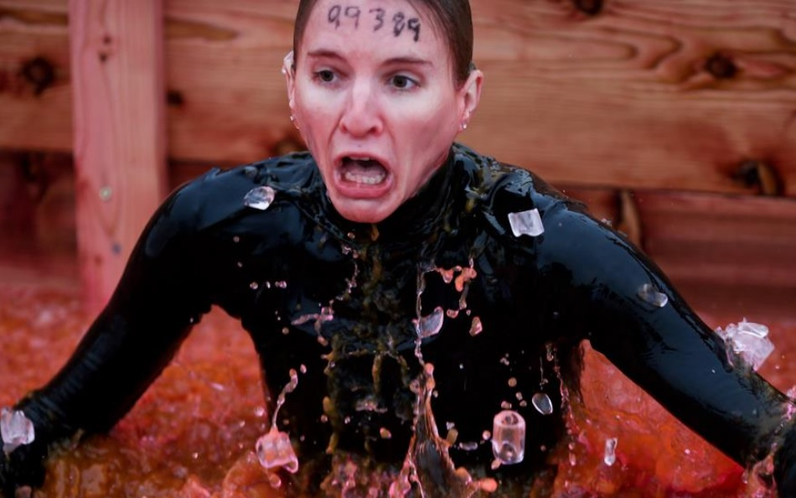

Slide 4
Electric Shock Therapy!
¹You, therefore, have no excuse, you who pass judgment on someone else, for at whatever point you judge another, you are condemning yourself, because you who pass judgment do the same things.

Slide 5
Electric Shock Therapy!
² Now we know that God’s judgment against those who do such things is based on truth. ³ So when you, a mere human being, pass judgment on them and yet do the same things, do you think you will escape God’s judgment?

Slide 6
Electric Shock Therapy!
⁴ Or do you show contempt for the riches of his kindness, forbearance, and patience, not realizing that God’s kindness is intended to lead you to repentance?

Slide 7
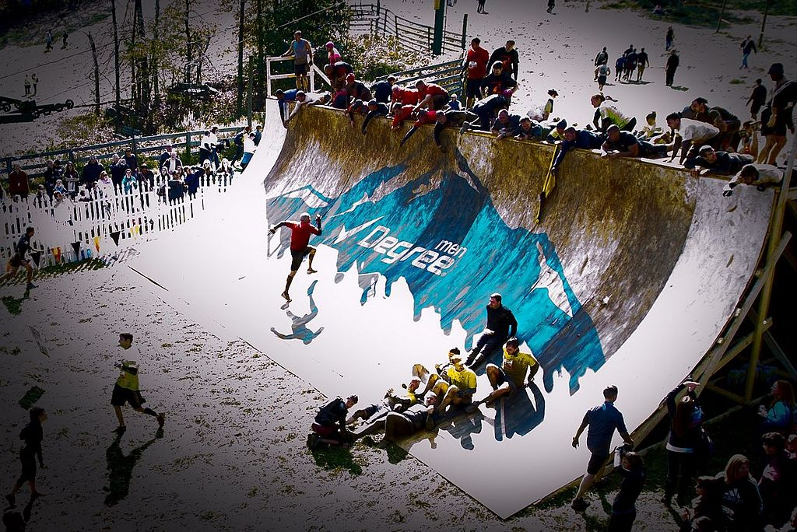

Slide 8
Everest
⁶ God “will repay each person according to what they have done.” ⁷ To those who by persistence in doing good seek glory, honour and immortality, he will give eternal life.⁸ But for those who are self-seeking and who reject the truth and follow evil, there will be wrath and anger.

Slide 9
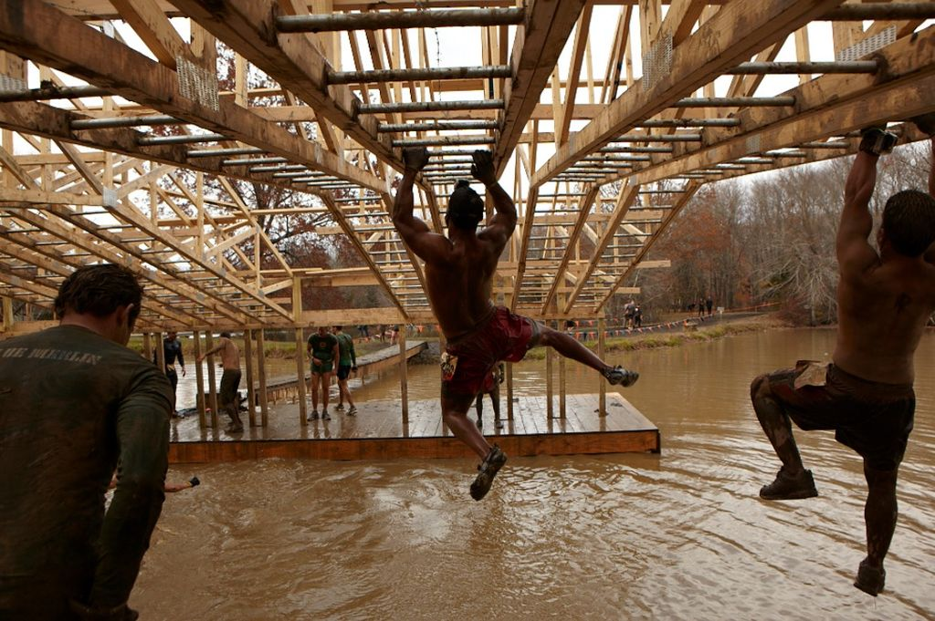

Slide 10
Funky Monkey
¹¹ For God does not show favouritism. ¹² All who sin apart from the law will also perish apart from the law, and all who sin under the law will be judged by the law. ¹³ For it is not those who hear the law who are righteous in God’s sight, but it is those who obey the law who will be declared righteous.

Slide 11
Funky Monkey
¹⁴ (Indeed, when Gentiles, who do not have the law, do by nature things required by the law, they are a law for themselves, even though they do not have the law. ¹⁵ They show that the requirements of the law are written on their hearts, their consciences also bearing witness, and their thoughts sometimes accusing them and at other times even defending them.)

Slide 13
Finish Line
¹⁶ This will take place on the day when God judges people’s secrets through Jesus Christ, as my gospel declares.

