Slide 1
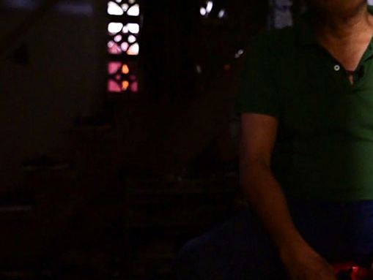
Loving Jesus – loving each other – loving our town

Slide 2
“Go, stand in the temple courts and tell the people all about this new life.”
— Acts 5:20

Slide 3
God never leaves us

Slide 4
“We must obey God rather than human beings!”
— Acts 5:29

Slide 5
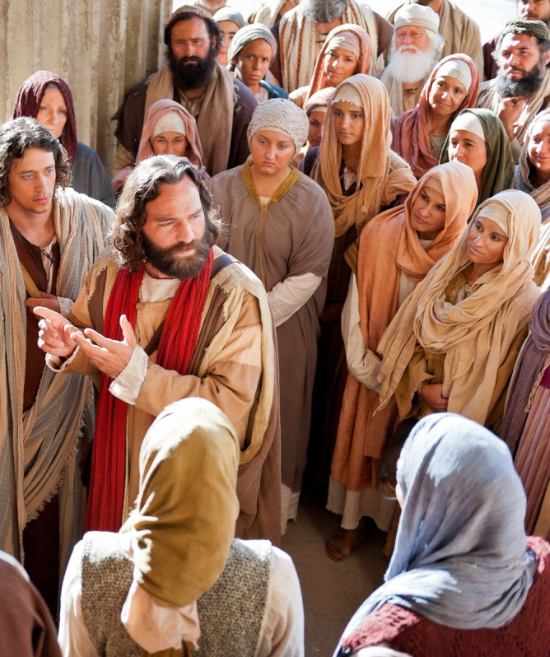
We must obey God

Slide 6
The apostles left the Sanhedrin, rejoicing because they had been counted worthy of suffering disgrace for the Name.
Day after day, in the temple courts and from house to house, they never stopped teaching and proclaiming the good news that Jesus is the Messiah.
— Acts 5:41-42

Slide 7
They rejoiced in their persecution

Slide 9
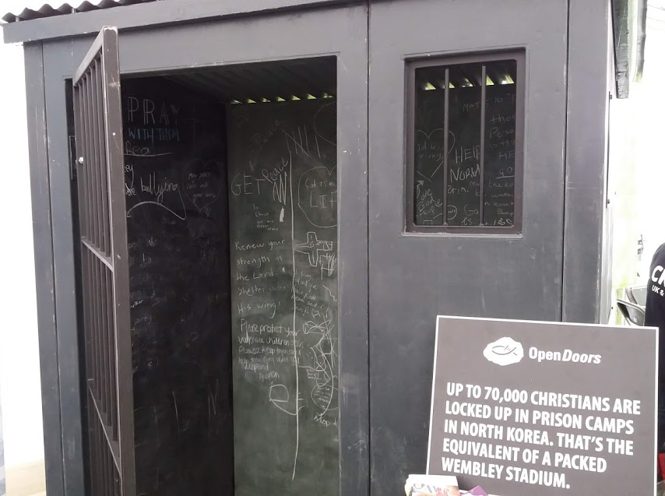

Slide 10
“Even though they are
suffering from many things in life, I encourage them to find hope and happiness through their hardships and live with hope for the eternal kingdom of God.”

Slide 11
“At the height of the famine,
a leader felt called to reintroduce the concept of ‘holy rice’, a practice whereby rice is set apart for use in God’s kingdom.

Slide 12
Ever since, these Christians don’t consume all the food they receive from us. They save some to give to people who are even worse off than themselves.

Slide 13
This gives them an opportunity to build trust and later share the gospel with these people”

Slide 15
Loving Jesus – loving each other – loving our town

