Slide 1
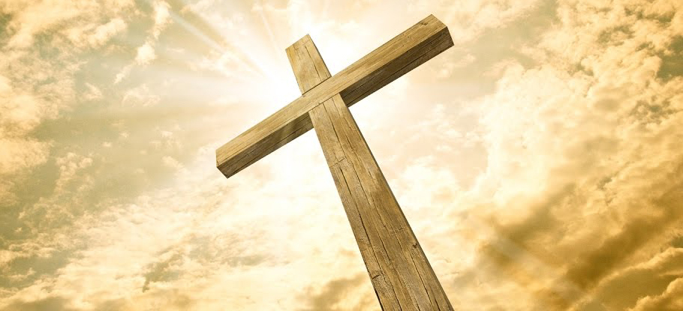
The Paradox of The Cross As Victory

Slide 2
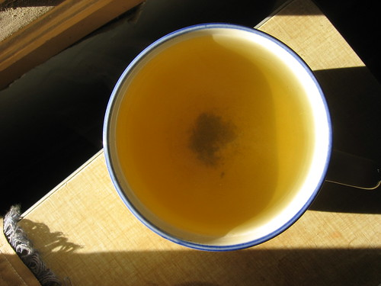
Tea Leaf Paradox
A paradox = Two apparently contradictory statements, which are actually true.

Slide 3
The Cross is Many Things
45 hymns about the cross.
The defining symbol of Christianity.
“An emblem of suffering and shame. so I cherish the old rugged cross.
Jesus Keep Me Near the Cross
Christian footballers?
Why do the Chinese and Muslims in Arab and Muslim countries target the cross when they attack churches?
Egyptian Christians called blue necks.
Muslim Messiah breaks the cross at the end of time?

Slide 4
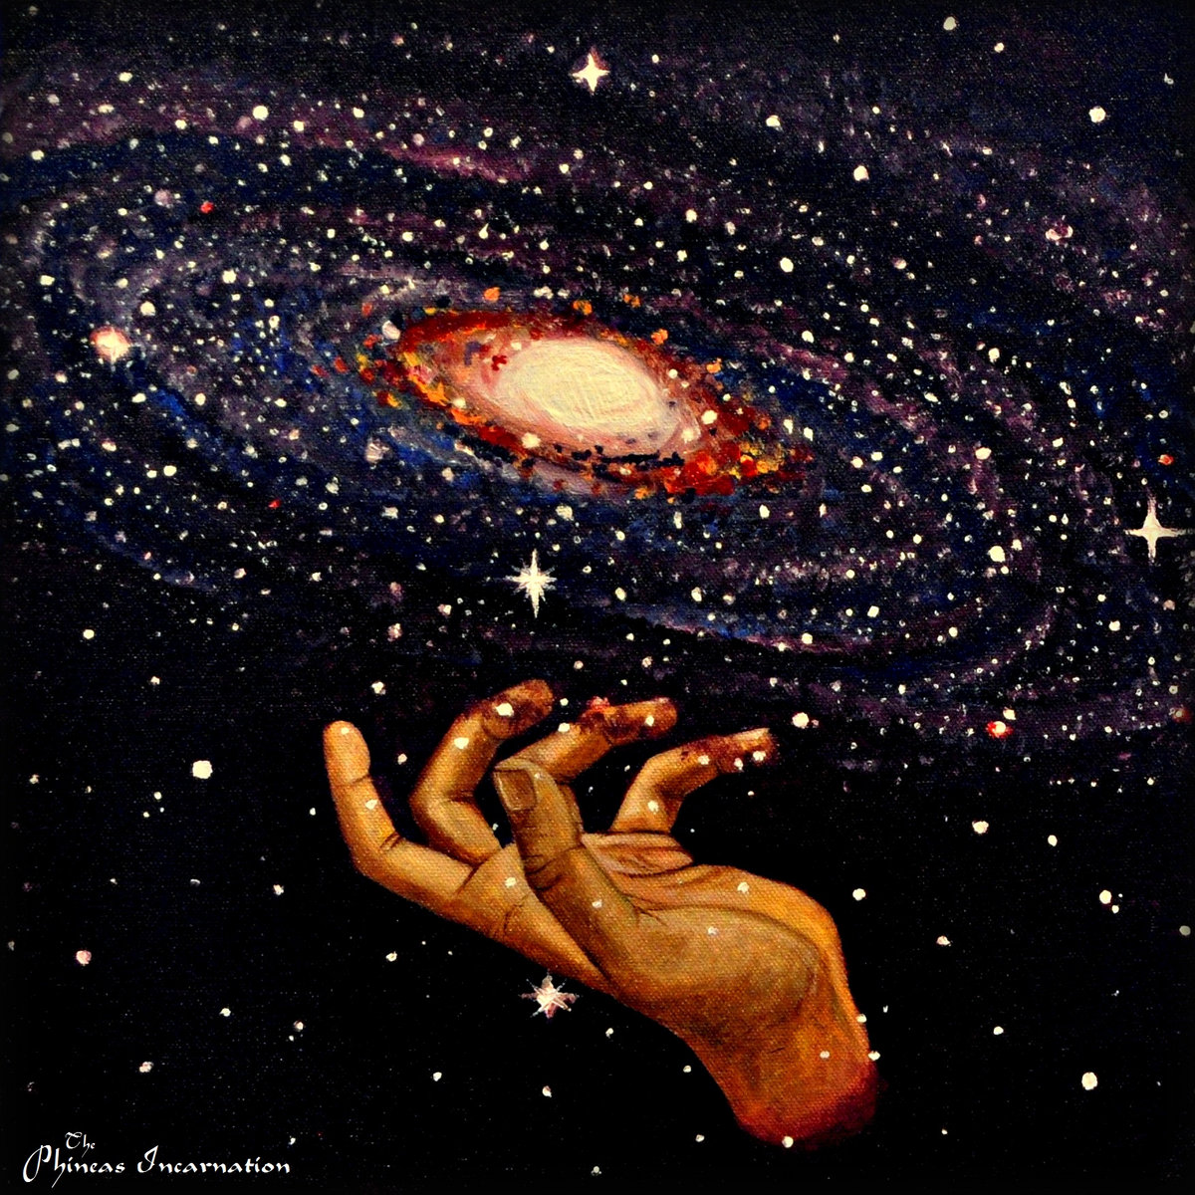
Divine Paradox
Man only seems to baulk at the divine
The God who created the Universe, is killed by a mob.

Slide 5
Victory
Winning against or defeating an opponent or enemy in a battle or competition:
An enemy
A war/competition
A cause
Triumph.
A Hero.

Slide 6
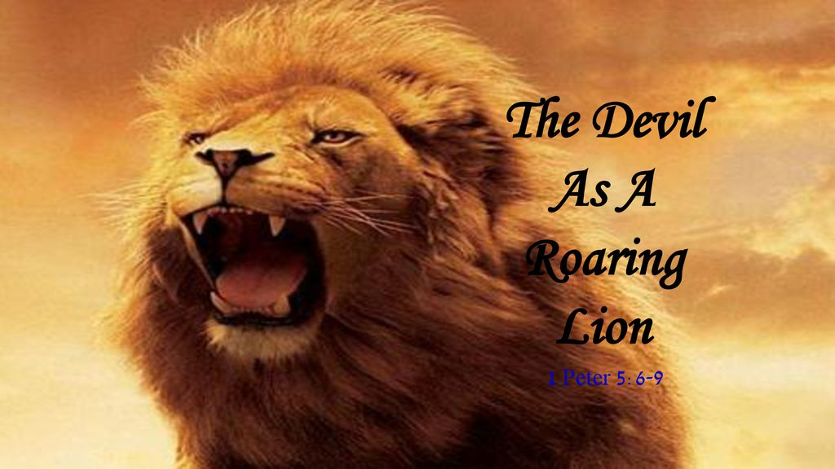
1. An Enemy

Slide 7
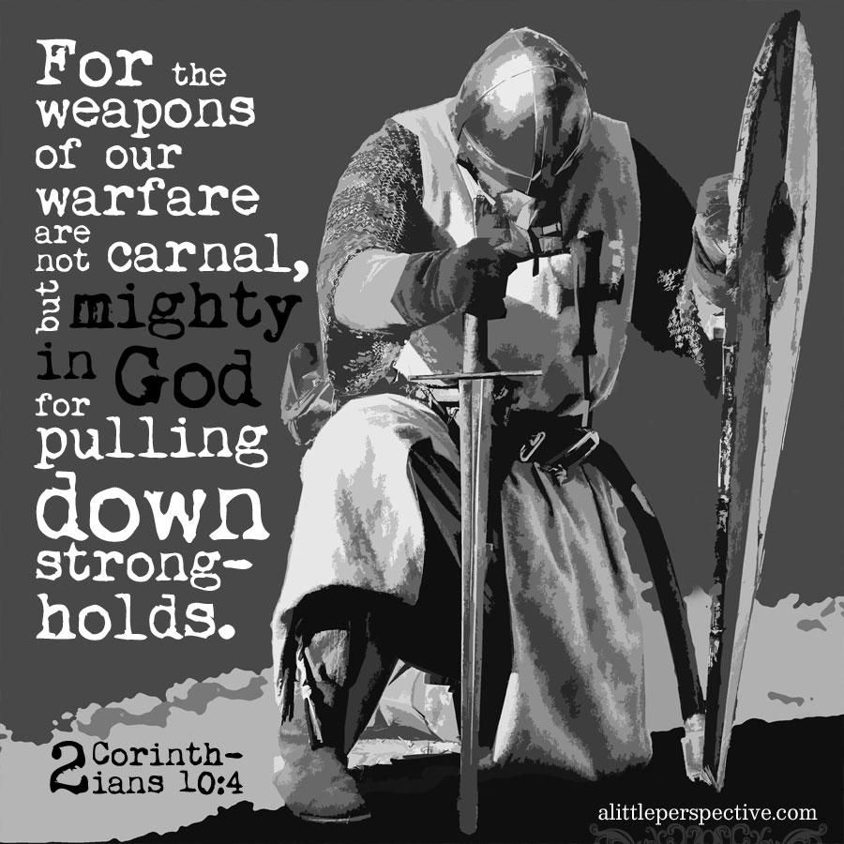
2. A War

Slide 8
3. A Cause

Slide 9
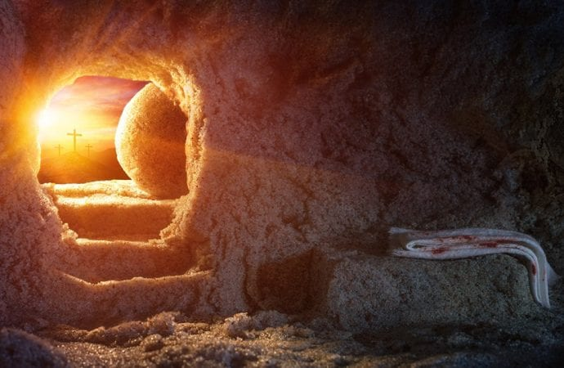
4. Triumph as the desired outcome
1 Corinthians 15:55-57 (KJV)
⁵⁵ O death, where is thy sting? O grave, where is thy victory?
⁵⁶ The sting of death is sin; and the strength of sin is the law.
⁵⁷ But thanks be to God, which giveth us the victory through our Lord Jesus Christ.

Slide 10
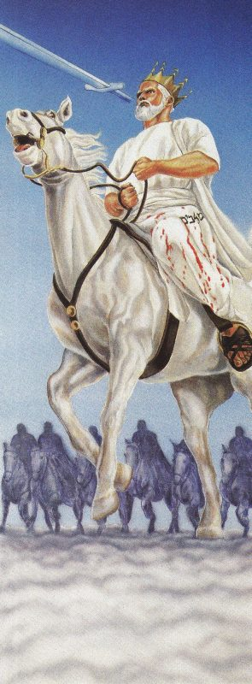
5.Christ the Victor/Hero.
Revelation 19:11-16 New King James Version (NKJV)
Christ on a White Horse
¹¹ Now I saw heaven opened, and behold, a white horse. And He who sat on him was called Faithful and True, and in righteousness He judges and makes war. ¹² His eyes were like a flame of fire, and on His head were many crowns. He ^{[a]}had a name written that no one knew except Himself. ¹³ He was clothed with a robe dipped in blood, and His name is called The Word of God. ¹⁴ And the armies in heaven, clothed in []fine linen, white and clean, followed Him on white horses. ¹⁵ Now out of His mouth goes a sharp sword, that with it He should strike the nations. And He Himself will rule them with a rod of iron. He Himself treads the winepress of the fierceness and wrath of Almighty God. ¹⁶ And He has on His robe and on His thigh a name written:
KING OF KINGS AND LORD OF LORDS.

Slide 11
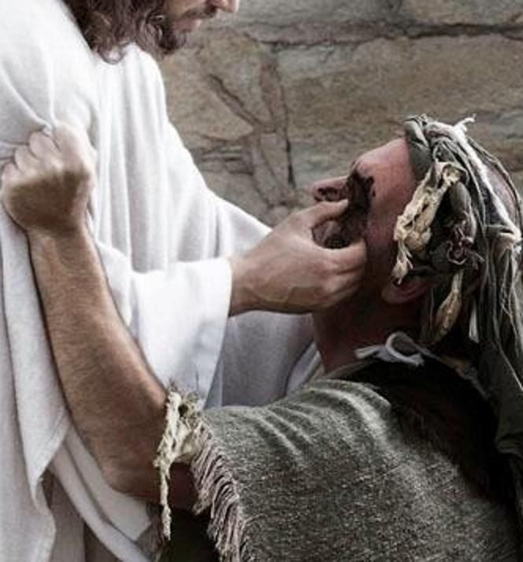
Paradoxes are Created by 1

Slide 12
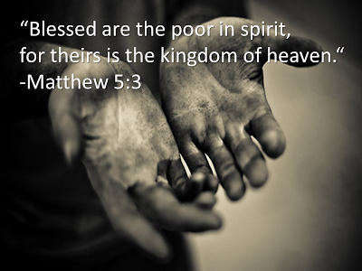
Paradoxes are Created by 2

Slide 13
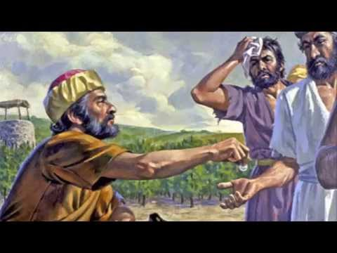
Paradoxes are Created by 3

Slide 14
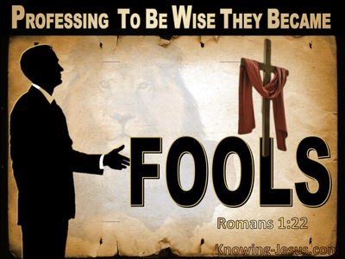
Paradoxes are Created by 4

Slide 15
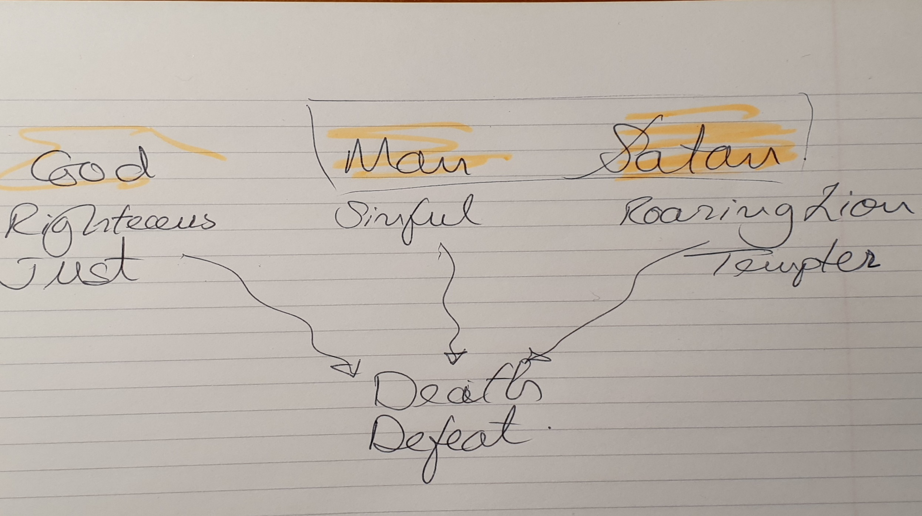
Battle for the Souls of Women and Men

Slide 16
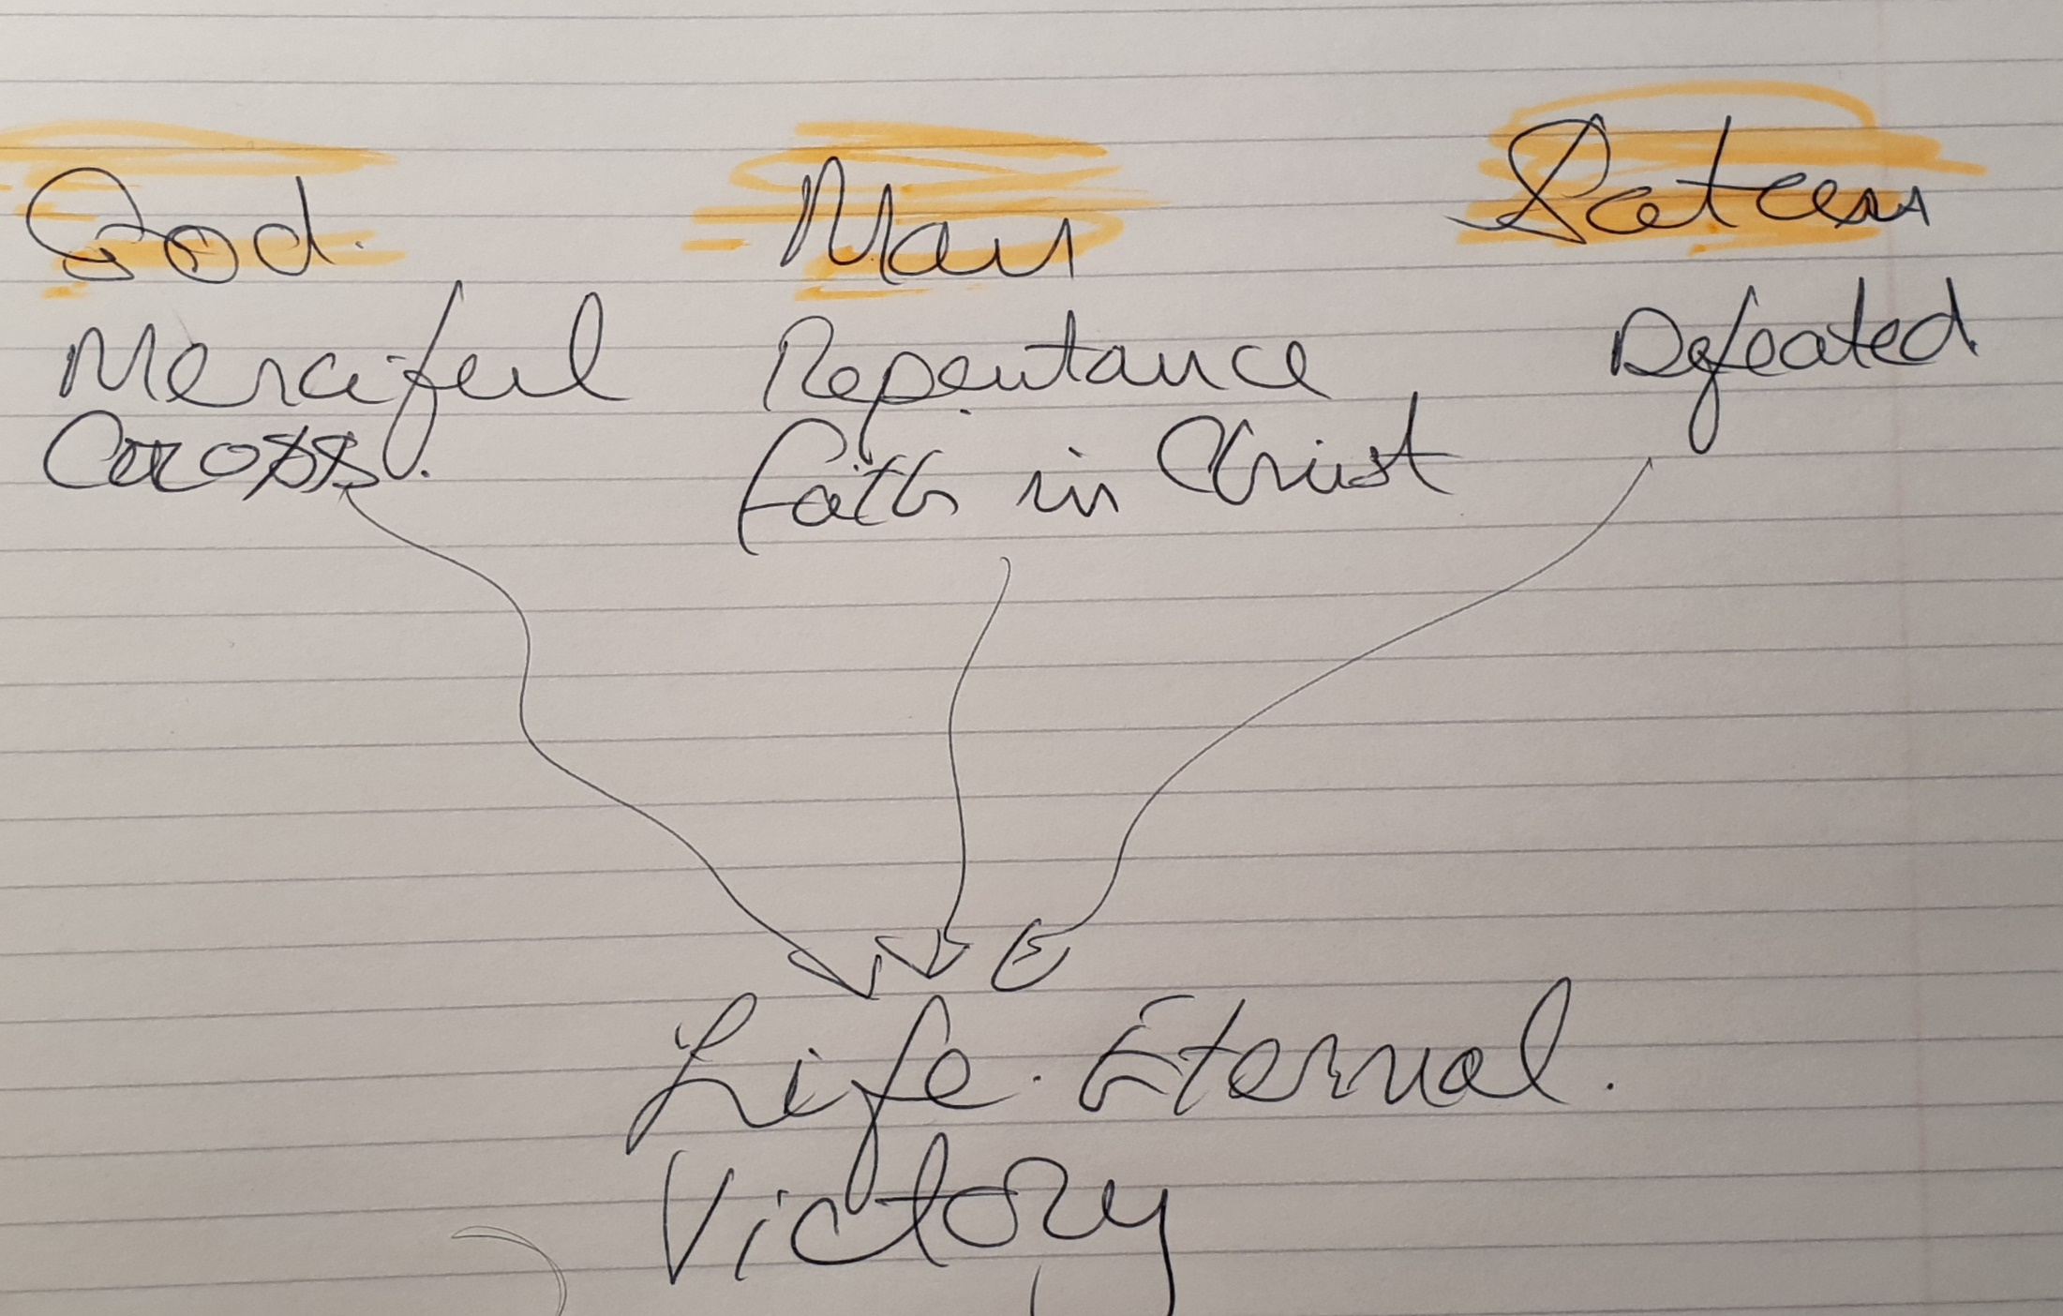
The Cross as Path to Life Eternal

Slide 17
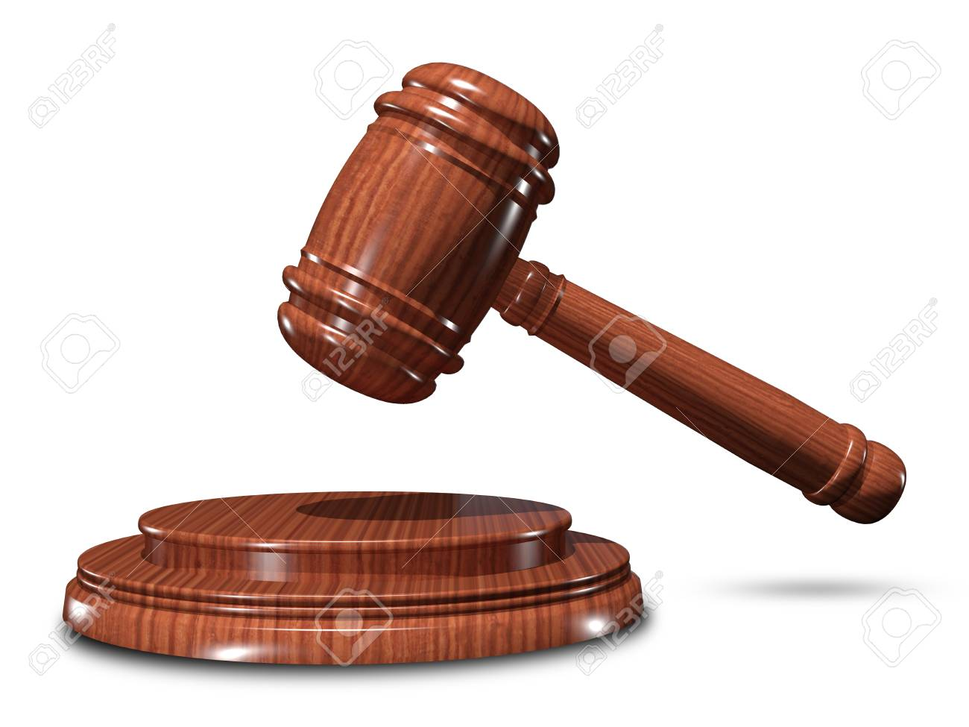
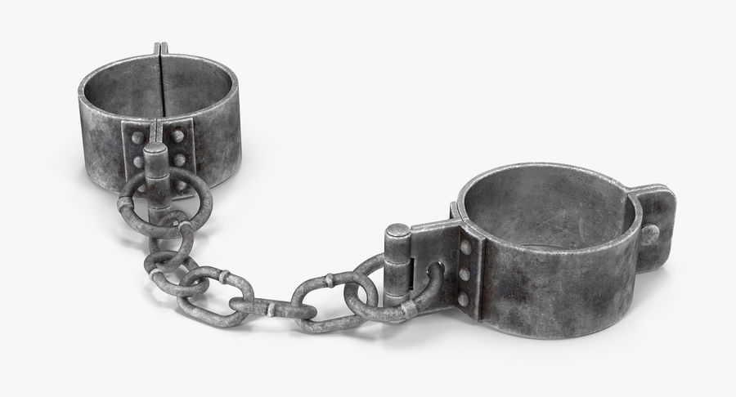
The Christian story retold:
Unfortunately, God is also a God of justice. So His laws must stand.
This means, all sinful humanity will go to hell.
Fortunately God is loving, merciful and full of grace.
Therefore, he became man and died on behalf of humanity.
Humanity can live forever, in the presence of the risen Christ.
This is commonly known as God’s plan of salvation.

Slide 18
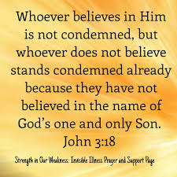
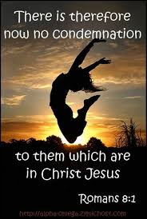

Slide 19
The Key word

Slide 20
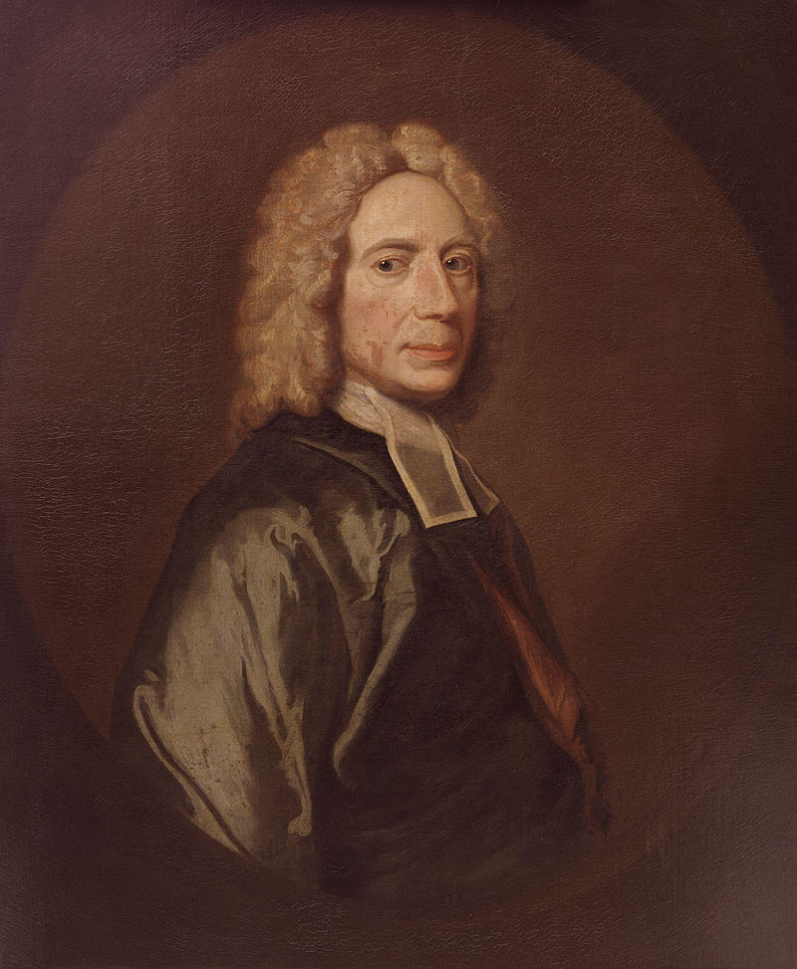
The Wonders of The Cross
When I survey the wondrous cross On which the Prince of glory died, My richest gain I count but loss, And pour contempt on all my pride.
See from His head, His hands, His feet,
Sorrow and love flow mingled down!
Did e’er such love and sorrow meet,
Or thorns compose so rich a crown? Isaac Watts, pub.1707

Slide 21
The Paradox Disarmed
Truth | Antinomy
Death | A cure for death
Christ's wounds | Our healing
Death of one | Brings life to many
He was in the form of God, | He took the form of a servant
Truth | Truth
Death | A cure for death
Christ's wounds | Our healing
Death of one | Brings life to many
He was in the form of God, | He took the form of a servant
Gods’ Love
Mercy
Grace

Slide 22
Paradox?
What Paradox?

Slide 23
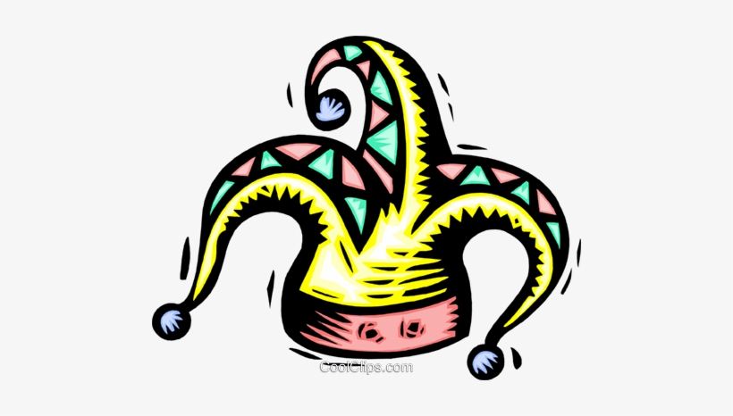
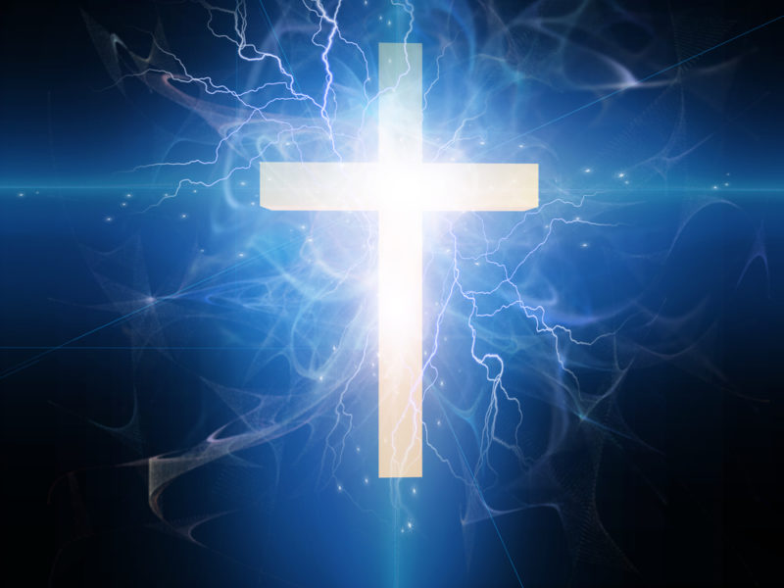
What is the Cross to You?
The Cross, Foolishness, a stumbling block
The Power and wisdom of God.

Slide 24
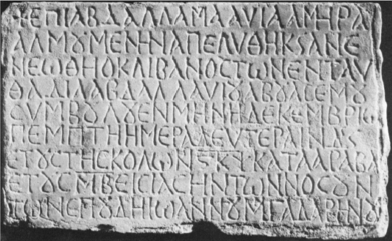
Caliph Mu’awiyah
Note the cross before his name (top left)
He died with t a golden cross fixed round his neck and felt at rest.

Slide 25
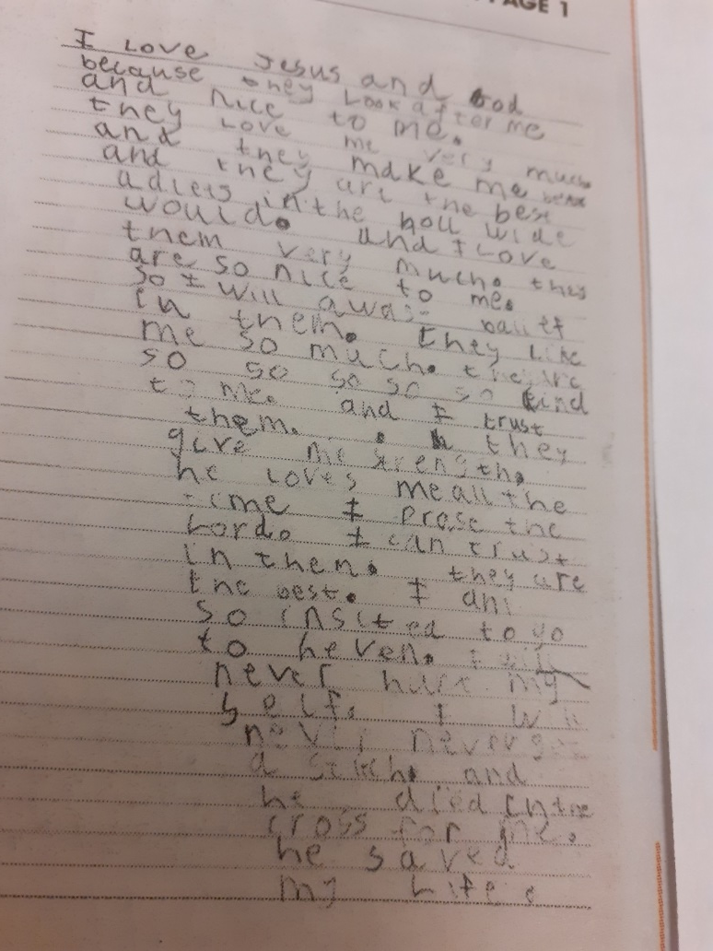
Samuel’s psalm (aged 6)
‘I love Jesus and God because they look after me and (are) very nice to me. They love me very much and they make me better and they are the best adults in the whole wide world. And I love them very much. They are so nice to me. So I will always believe in them. They like me so much. They are so so so so so kind to me and I trust them. They give me strength. He loves me all the time. I praise the Lord. I can trust in them. They are the best. I am so excited to go to heaven (where) I will never hurt myself. I will never never get a stitch. And he died on the cross for me. He saved my life.’

Slide 26
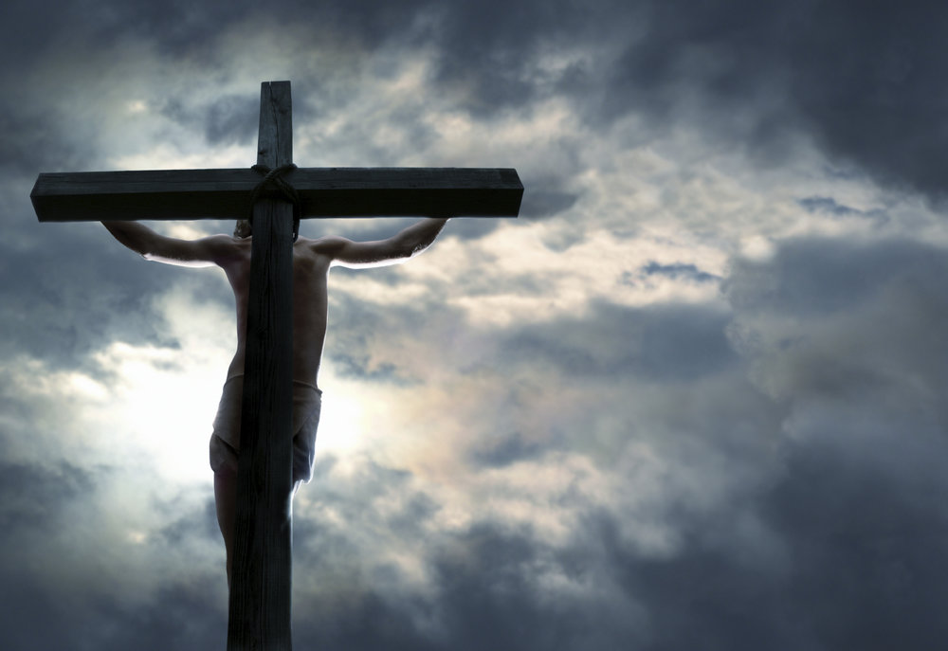
The Cross Is Victory

Slide 27
I am no longer a slave of sin
The wrath of God was satisfied
How can it be.
When I survey the wondrous cross
Jesus, Keep Me Near The Cross https://www.youtube.com/watch?v=MxRnzJT5mvo
The Old Rugged cross https://www.youtube.com/watch?v=avjXaEFKd5E
At the cross at the cross where I first saw the light
https://www.youtube.com/watch?v=nRGztDDyxJY
Nailed to the Cross https://www.youtube.com/watch?v=LFC8P4EI9_0

