Slide 1
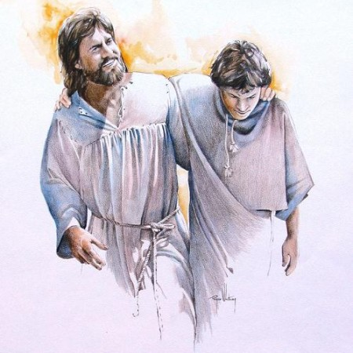
Total God:
Relationship First
John 15: 1-17
Whitfield Parish
Loving Jesus – Loving each other – Loving our town

Slide 2
This term Continuing next term
Relationship with Him
Reading God’s Word
Talking & hearing with Him
Taking your part in the body of His church
Engaging with His Spirit
Telling His story to others
Work and calling
Family
Friendships
Leisure
Money
Sex and relationships
Power and justice
Changing seasons of our lives
Whitfield Parish
Loving Jesus – Loving each other – Loving our town

Slide 3
What is a disciple?
Whitfield Parish
Loving Jesus – Loving each other – Loving our town

Slide 4
Relationship first
Connection with Jesus
What’s it all about?
What’s it all for?
Whitfield Parish
Loving Jesus – Loving each other – Loving our town

Slide 5
How do we abide or remain?
Whitfield Parish
Loving Jesus – Loving each other – Loving our town

Slide 6
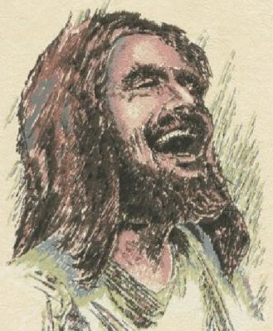
The Hub
Relationship with God
Forgiveness & Rescue
New life
A variety of other benefits!
Eternal life
The spokes – rest of this term
The rim – next term
Whitfield Parish
Loving Jesus – Loving each other – Loving our town

Slide 7
The Response
Disciple?
Theist or agnostic?
Weeds of life?
Whitfield Parish
Loving Jesus – Loving each other – Loving our town

Slide 8
I am sorry for the things I have done wrong in my life. Please forgive me. I now turn from everything which I know is wrong.
Thank you that you died on the cross for me so that I could be forgiven and set free.
Thank you that you offer me forgiveness and the gift of your Spirit. I now receive that gift.
Please come into my life by your Holy Spirit to be with forever so I can be loved by you and love you, love others and bear fruit.
Thank you, Lord Jesus. Amen
Whitfield Parish
Loving Jesus – Loving each other – Loving our town

