Slide 1
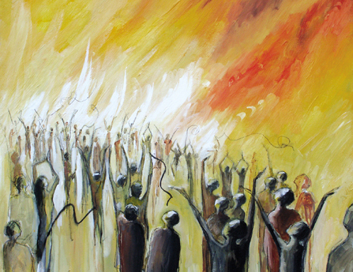
Worship: Prophecy, a Special Gift
1 Corinthians 14: 1-19
Whitfield Parish
Loving Jesus – Loving each other – Loving our town

Slide 2
Use the full tool kit!
Inside and outside of the church
……just like Jesus!
Whitfield Parish
Loving Jesus – Loving each other – Loving our town

Slide 3
Opening up the passage….
Eagerly desire….especially prophecy
To strengthen, encourage and comfort
To build up the church
Expect God to speak!
Whitfield Parish
Loving Jesus – Loving each other – Loving our town

Slide 4
What is prophecy?
A message from God. A revelation about a person or situation, given by the HS, and spoken out for the benefit of others
Strengthen, encourage and comfort
(1 Cor 14 :3)
Whitfield Parish
Loving Jesus – Loving each other – Loving our town

Slide 5
How can this be expressed?
Passage of scripture
a message (or word)
a statement
a vision
a picture
an impression or sensation
Who?
Where?
Whitfield Parish
Loving Jesus – Loving each other – Loving our town

Slide 6
How can we be wise?
Weigh
Humility
Strengthen, encourage and comfort
Search our hearts – beware manipulation!
In line with scripture
Whitfield Parish
Loving Jesus – Loving each other – Loving our town

Slide 7
Naturally supernatural
Loosen us up Lord…..
Let’s hear God speak at St Luke’s!
Whitfield Parish
Loving Jesus – Loving each other – Loving our town

